Slide 1
Data Link Layer(1)
Relationship to Network Layer
Error control
  Democratic voting strategies
  error detection and correction
  Parity
  Hamming distance
  CRC codes
Framing
Notes:
In this lecture we will discuss some of the ways for dealing with real transmission where errors are introduced.
First we look at a simple voting strategy for transmitting information on a noisey line. No explicit error control is used in this case.
We can distinguish between error detection, where for example an error can be detected but the nature of the error is unknown, and error correction where an error can both be detected and corrected. It is not possible to correct for all possible errors so error correction can only work for a range of possible errors. Different codes will be able to detect for different types of error and the selection of the most suitable code will depend on the details of the transmission line. In some cases, bursts of errors are much more likely than isolated errors but these can be accommodated.
We will also discuss the issue of framing which arises from the need of the data link layer to be able to tell when a sequence of bits starts and stops.

Slide 2
Relationship to Network Layer
Get data from NL on source to NL on destination
Provide Services e.g.
  Unacknowledged connectionless service
  Acknowledged connectionless service
  Acknowledged connection-oriented service
Notes:
The main goal of the data link layer is to transfer data between the two network layers at the ends of the link. These network layers will not in general be part of the ultimate source and destination machines for the message.
The data link layer provides a set of services to the network layer and it is up to the network layer to specify which service it needs. The following are typical (but not compulsory) services
1. Unacknowledged connectionless service
This is the most basic form of transmission. Frames are sent out to the destination without establishing a connection (and hence a path) and without waiting for any acknowledgements. If data is lost it would be up to higher layers to recover (if recovery is needed). This service is suitable for very reliable physical layers where frame loss or corruption is rare. It has a very low overhead thus making efficient use of the available bandwidth. It is also suitable for transmission where data loss is not critical (e.g. real time services).
2. Acknowledged connectionless service
As in 1. but frames must be acknowledged. The data link layer takes the responsibility for retransmitting lost frames. This service would be more appropriate in the case where the physical layer is not perfectly reliable. It would be possible for problems to be recovered at higher layers but that would require re-sending entire messages rather than individual frames.
3. Acknowledged connection-oriented service
As in 2 but with a pre-negotiated connection between source and destination. The order of frames is guaranteed by this service, this involves numbering the frames. This service requires the most use of resources in the layer.

Slide 3
Voting
No error control
Re transmit the information N times
Receiver accumulates the results and treats them as votes on individual bits.
Error probability per bit is p
Mean number of received bits = N(1-p)
Threshold at N/2
Notes:
If we have no explicit error control, we could consider using a democratic voting strategy. The information frame is sent N times to the receiver. When each frame arrives it forms the decimal sum of the total number of bits received in each slot.
The width of the distribution of the number of bits received will scale as 1/N so provided the peak of the distribution at N(1-p) is more than 1/ N above the threshold value of N/2 the probability of an error is greatly reduced.
Of course this strategy is enormously wasteful in bandwidth.

Slide 4
Error Control
Real transmission is never error free
Error detection
  knowing there is an error but not where
Error correction
  knowing there is an error and being able to work out where it is
Here ‘an error’ really means ‘an error syndrome’ which refers to a collection of specific errors in general.
Notes:
Errors in transmission lines can come from various noise sources. Truely random events such as thermal receiver noise or quantum fluctuations in the Poisson statistics of photons will generally give rise to Poisson distributed single bit errors.
Other noise sources can include external influences such as crosstalk from another system. In some cases these will give rise to a burst of errors. A burst is defined as a sequence of bits for which the first and last bits are in error and the intervening bits might be.
We will often refer to an error when we should really say an ‘error syndrome’. An error syndrome is a more general term indicating that any number of bits may be in error.
The general idea of these codes is to transmit more bits in the message than there are in the original data. The extra bits carry redundant or distributed information about the message bits. Clearly this reduces the effective data rate of the transmission relative to the raw line rate. It does of course increase the effective information transmission rate.
In general error correcting codes require more overhead than error detecting codes since more information is required to work out exactly what went wrong.

Slide 5
Error Control Codes
Detection is the ability to detect but not correct
  parity is the classic example
    p = b_{n}  b_{n-1} ............b₁  b₀
     = exclusive or
    only useful when bit error rate is very small
Hamming Distance
  H(a,b) = decimal sum (a_{n} b_{n})
  H(10100, 11010) = (0+1+1+1+0) = 3
  if H(a,b) = d then d single bit errors are needed to change a into b
Notes:
The inclusion of a parity bit is the classic example of a simple code which can detect single bit errors but not correct them. In the context of packet transmission a re-transmit request would be issued to the source node following the detection of an error. A single parity bit is unable to detect two bit errors which are the next most likely random error to occur. The parity is simple to generate as the cumulative Exclusive Or of the message bits and is commonly generated in hardware.
To deal with a simple error correcting code we introduce the concept of the Hamming distance between two words. It is simply the number of individual bits in the two words which are different. To put it another way, it is the number of bits in either word which need to be changed to make them the same.
Note that a simple coding scheme like 1->1111111111, 0->0000000000 is an example of a voting scheme.
We now introduce a geometrical picture of codes.

Slide 6
Codes as Vectors
111
011
001
101
010
110
000
100
Notes:
The slide shows a simple example of the possible words that can be formed using three bits. They are represented on three dimensional axes as the points on the vertex of a cube as shown in the slide.
The edges of the cube represent transitions from one word to another by changing a single bit. For example the solid axes represent the transitions:
(000) to (001)
(000) to (010)
(000) to (100)
Suppose we now represent a single message 0 by the code (000) and a single message 1 by the code (111)
A single bit error on (000) will change the word to one of the set {(010),(100),(001)} and a single bit error on (111) will produce one of the set {(011),(101),(110)}. Since these two sets are distinct we can immediately tell if we receive (101) that (111) must have been transmitted and so produce the correct code. Note that any of the pairs on the diagonals of the cubes could be used to represent the single message bits. Indeed in some cases it may be preferable to use a pair like {(101),(010)} in order to avoid extended sequences of ones or zeros.
If we tried to squeeze more message bits into this space we would find some words which are reached by single bit errors from more than one code word making the error correction impossible.

Slide 7
Dimensions
Use d code slots (work in d-dimensional space)
Total number of code words = 2^{d}
Each point has d neighbours reachable with a single bit error
To be able to correct all single bit errors make all d+1 clusters distinct
So (d+1)2^{k}  2^{d}
where k is the number of bits to be encoded.
E.g. d=3 gives k=1
Notes:
With more message and code bits it would be necessary to plot the points in a higher dimensional space which we can’t do but the general geometric picture is still valid in this case.
Suppose we use a total of d code slots so that there are 2^{d} possible code words. If we want to correct for single bit errors then each transmitted code word has to be surrounded by code words that are equivalent to it (i.e. when a single bit error occurs) but are not transmitted. Since a point on a d-dimensional cube has d nearest neighbours each message word is associated with d+1 code words. If we have k message bits then there will be 2^{k} message words each associated with d+1 code words. In order for the code to work the desired number of code words
2^{k} (d+1)
has to fit in the space which has size
2^{d}
giving the criterion quoted on the slide.

Slide 8
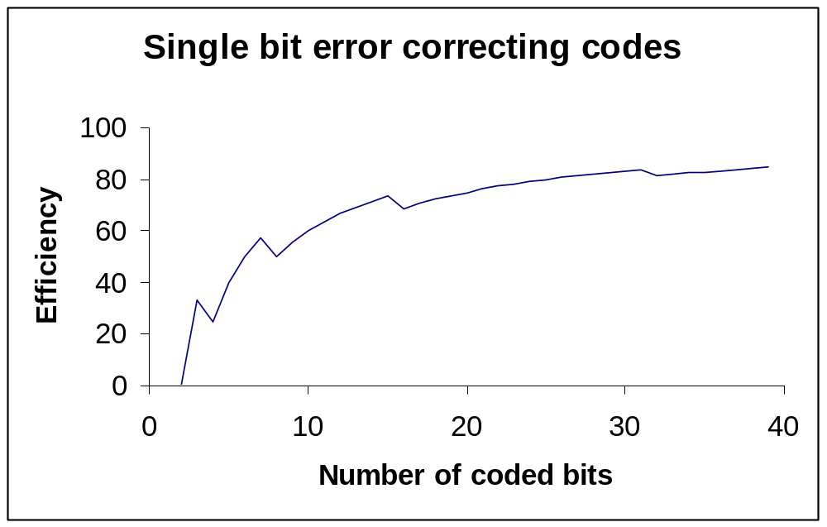
Efficiency
Define efficiency as ratio of coded bits to code bits= k/d
Notes:
The efficiency of a code can simply be defined as the ratio of the wanted message bits to the total code word bits.
This graph shows the efficiency for codes satisfying the bound derived in the previous slide. This curve approaches the asymptotic value of 100% very slowly so that in order to preserve efficiency very large message blocks must be coded.
The Hamming codes discussed in section 3.2.1 of Tanenbaum are examples of codes satisfying the bound.

Slide 9
CRC codes
One of the commonest sets of codes used are the:
Cyclic Redundancy Codes or polynomial codes
  based on Galois field theory
  use arithmetic modulo 2
  represent data as polynomials
  can be constructed to correct for a wide combination of errors
Notes:
Their properties can be derived from Galois field theory, a branch of mathematics describing modular arithmetic. First we will review arithmetic modulo 2 and look at some of the simple polynomial operations that are used. Then we will look at how the code words are formed from the generator polynomials and what the simple properties of the codes are.
This formalism is also used to discuss the properties of pseudorandom number generators that are used in bit error rate test equipment.
Some of the widely used codes have been defined as international standards.

Slide 10
Modulo 2
Strictly speaking this is an algebraic field and although we write things that look like numbers they do not have a carry associated with them.
With carry:
101
001
110
Without carry:
101
001
100
Notes:
In this slide we review the basic operation of addition modulo 2 performed at the level of a single bit. This operation is perhaps better expressed as the bitwise exclusive or of the two bit strings since addition implies the existence of carry bits both for addition and subtraction. The message bit strings we wish to encode are really lists of bits and not numbers (even if, coincidentally, they represent a number). The slide illustrates the two results that would be obtained with and without carry.
The ‘with carry’ calculation is appropriate if the bit strings represent numbers and the one shown in the slide corresponds to 5+1=6.
The ‘without carry’ result is simply the result obtained by applying the rules I have given you. It should not be interpreted as having any numerical significance.

Slide 11
Polynomial representation
This is clearer if we use a polynomial representation:
the bit string 1101 is represented by the polynomial
x³+x²+1, the coefficients of the polynomials can only be 0 or 1
Now the sum 101 + 001 becomes
x²+1+1 = x², since 1+1 = 0
We can also multiply and divide in this representation
(1+x²)(1+x²) = 1+x²+x²+x⁴ = 1+(1+1)x²+x⁴=1+x⁴
Notes:
The bit strings can be represented as polynomials and shows why there is no carry operation. The bit string is read from left to right with the first bit being the coefficient of x^{k-1} where k is the number of bits in the string. The next bit is the coefficient of x^{k-2} and so on until the rightmost bit which is the coefficient of x⁰.
The lack of a carry come from recognising, for example, that x+x is not x² but x(1+1) = 0.

Slide 12
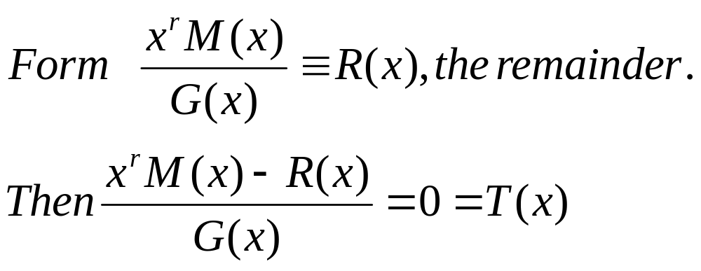
CRC coding
Let M(x) be the message polynomial and define G(x) to be a generator polynomial of degree r
T(x) is now the code to be transmitted. If errors occur, what is received is not T(x) but T(x)+E(x) where E has a coefficient of 1 for each position where an error has occurred. We can now divide the received polynomial T(x)+E(x) by G(x) and obtain E(x)/G(x) which characterises the error syndrome.
Notes:
Division proceeds by using the techniques we first used in primary school. An example of such a calculation can be found in figure 3-7 of Tanenbaum.
The remainder is calculated in the way shown in the slide. For comparison, suppose we take the numerator to be the number 51 and the denominator to be the number 7. The remainder would be 2 since 51=7*7+2. This can be rearranged by subtracting the remainder (2) from both sides to get
(51-2)/7 = 7 rem. 0 or in modulo 7 arithmetic 49/7 = 0.
Thus given any message polynomial the procedure produces a code polynomial which is exactly divisible by the generator polynomial.
When an error polynomial is added by the transmission line the received code is divided by the generator to reveal the error syndrome (apart from factors of the generator polynomial).

Slide 13
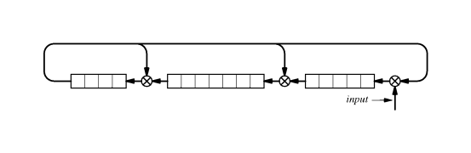
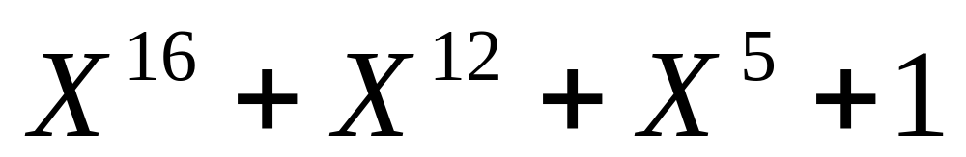
CRC Hardware
Notes:
The CRC codes can be implemented very easily in hardware. They use shift registers with taps at the appropriate points where the bit fed back and the previous shift register position are combined in an exclusive OR gate. The shift register shown here implements a standardised code known as CRC-CCITT.
The message is applied to the input and the result after it has passed through the register is the CRC code to be appended to the message.
The file lecture4.xls (available on the web) is an excel spreadsheet implementation of the CRC code shown in the slide. There are two sheets, one for the transmitter and one for the receiver.

Slide 14
Framing
Data Link layer
  responsible for extracting packets from a bit stream
  uses special characters to identify start and end of frame
  needs to hide their natural occurrence
  use of stuffing
e.g. Start = esc S, End = esc E
  also need to hide any natural esc by translating to esc esc
Notes:
One function of the Data Link layer is to determine the presence of packets within bit streams. This is done by making certain bit combinations special. However, it is possible that these combinations will occur as part of the data and the purpose of framing is to code them in such a way that they do not interrupt the frame detection process.

Slide 15
Framing example
The message
A esc S esc esc D
becomes
esc S A esc esc S esc esc esc esc
D esc E
where the extra characters have been highlighted.
When the inverse translation is applied the original message is recovered.
SLIP is an implementation of this sort of framing.
Notes:
The slide shows a short message undergoing framing. The start and end sequences have been added as usual. The message actually contains an esc S sequence which would cause a problem if left alone. The translation of esc to esc esc gets round this. When the message come sot be reconstructed the first double occurrence is treated as a single escape and the S that follows is allowed to pass without being treated as a special character. The example also shows that multiple occurrences of the esc character can also be handled.
The Internet data link protocol SLIP (Serial Line IP) is an example of this sort of framing. It is typically used over a modem to connect to an Internet provider. The protocol does not provide any other functionality so negotiation, dynamic IP allocation and error control are not allowed for.

Slide 16
Next Lecture
Data Link layer protocols
  Simple perfect channel
  Stop and wait
  Errors and lost frames
  Sliding windows
  Analysis
The Internet protocol PPP
Notes:
In the next lecture we will consider some simple data link layer protocols and show how different channel properties introduce different requirements into the protocol. One way links, bi-directional communication and the problems of noise and lost frames will be discussed.
We will briefly mention the analysis of protocols through methods such as finite state machine models.
We will also study the main Internet protocol used over modems, PPP.

